Slide 1

CMR COLLEGE OF ENGINEERING & TECHNOLOGY
Kandlakoya, Medchal, Hyderabad - 501401
Department of Computer Science and Engineering
Whiteboard application using machine learning model
Name of the student & Roll.No.
Kommalapati Sandeep (20H51A0514)
Saba Zareen (20H51A0574)
Vennam Eshwar (20H51A05G0)
Under esteemed guidance of
Guide Name : Mr. V. Narasimha

Slide 2
Outline
Abstract
Introduction
Literature survey
Existing system
- Problems in existing system
Research Objective of Presentation
Problem Definition
Research work
- Proposed system architecture
- Methods
- Comparison of Proposed system with an existing system
Performance Measure
Results
Conclusion
Future Work
References
Notes:
2

Slide 3
Abstract
Notes:
3

Slide 4
ABSTRACT
The Whiteboard Application Using OpenCV is a digital platform designed to replicate
the functionality of traditional physical whiteboards while harnessing the capabilities
of computer vision technology. This application allows users to draw, write, and
collaborate in a digital space, enhancing remote communication, creative expression,
and interactive learning experiences. The application supports real-time collaboration,
allowing multiple users to engage in synchronous drawing and annotation on a
shared canvas. The integration of collaborative features promotes remote teamwork,
virtual brainstorming, and interactive educational sessions. The application includes
an undo/redo functionality that maintains a history of actions, enabling users to
correct mistakes or explore different design iterations without limitations. The user
interface (UI) is designed for ease of use and efficient navigation. The intuitive
interface ensures that users, regardless of their technical proficiency, can seamlessly
access and employ the application's features.

Slide 5
INTRODUCTION
Notes:
5

Slide 6
The whiteboard application is used to train our laptop or our screen to read whatever the user will be writing Infront of the screen in the air and that will be displayed on it. We will use some of the machine learning and deep learning libraries which includes open cv algorithms and functions are used for various tasks related to image processing, computer vision, and user interface development. To track the detected hand over time, we use various tracking algorithms, such as optical flow, deep sort, to estimate the motion of pixels between consecutive video frames, allowing you to track the hand's movement freely. We also use CNN algorithm to train dataset of hand gesture images to recognize specific gestures. And a user interface which is like a software on which all this can be happen and used by the end users.
Introduction
Notes:
6

Slide 7
Literature Survey

Slide 8
S.No | Authors and Journal Name& Year of publication | Problem Statement | Name of the Proposed solution/Method | Solution | Remarks
1 | Dr. S. K. Sonkar | International Journal of Advanced Research in Science, Communication and Technology, 2021 | In the software industry many whiteboard software are available. Each of them has its own pros and cons. One of the main disadvantages of these whiteboard software is the need of accurate pointing devices. Here we introduce the Smart virtual Board, which is a hand movements based writing software. It uses the hand movements for writing. | Virtual Teaching Board Using Computer Vision. | Direct use of hands as an input device is an attractive method for providing natural human - computer interaction which has evolved from text based interfaces through graphical based interfaces. hand movement recognition can be seen as a way for computers to begin understanding human body language. This project propose a camera based Human Computer Interaction system in which movements of user's hand is directly involved in creating and manipulation of art. | It mainly focuses on interacting with the system using hand movements using opencv.
2 | Ankita Yadav | International Journal of Research Publication and Reviews, 2023 | Develop a gesture-controlled virtual whiteboard that eliminates the need for physical writing tools, allowing users to interact with digital content in a pen-free manner. Create a cost-effective alternative to traditional whiteboards by harnessing computer vision and gesture recognition technology, reducing the reliance on physical writing tools and offering a practical, sustainable, and innovative platform for diverse applications. | Virtual Whiteboard-A Gesture Controlled Pen-free Tool | This project allows users to control their PowerPoint presentations using hand gestures, making it a useful tool for public speakers and presenters. With this feature, users can advance or go back to slides, as well as draw or annotate over the slides in real-time. Overall, the Virtual Whiteboard is a powerful and versatile tool that enhances user experience and interaction, providing a new way to create and control digital content. | It focuses on interacting with the system using hand gestures but particularly on the PowerPoint presentations for explaination..

Slide 9
S.No | Authors and Journal Name& Year of publication | Problem Statement | Name of the Proposed solution/Method by authors | Solution | Remarks
3 | Baline Yugendhar | International Journal of Creative Research Thoughts , 2023 | To create a virtual teaching software tool that may be used as an alternative to traditional ways of teaching. We also sought to make it as simple and user-friendly as possible, with very minimum hardware requirements, so that even someone with no prior computer experience could use it. | Virtual Teaching Board | This project cuts the utilization of digital stylus and interacting with the screen. The proposed system assist the user to accomplish hand gesturing in systematic and cost-effective manner. later the system is set up, the User involvement can be increased highly, which makes it even easier for a user because they can interact easily and effectively with the system, alternate usage of traditional softwares . | This project uses hand gestures which easy to interact and also a calculator to do on the screen and different hand gestures for different actions .
4 | Swapna Singh | IPEC Journal of Science & Technology, 2023 | The systems has difficulty detecting the up and down movements of the pen as it only uses one RGB camera. As a result, the finger path is abstract and not easily recognized by the model. Real-time hand touch is required to change positions, which requires careful coding and the user must be familiar with various movements to control the system effectively. | Digitized Interaction: A Gesture-Controlled Whiteboard System with OpenCV, MediaPipe and NumPy | The hand detection algorithm implemented using OpenCV successfully identified hands in real-time with minimal false positives or false negatives. The hand landmark estimation provided by MediaPipe accurately tracked the positions of fingertips, enabling precise tracking of finger movements for writing or drawing on the whiteboard. | The gesture-controlled whiteboard system developed using OpenCV, MediaPipe, and NumPy demonstrated promising results in terms of accuracy, performance, and usability.
S.No
Authors and Journal Name& Year of publication
Problem Statement
Name of the S.No
Authors and Journal Name& Year of publication
Problem Statement
Name of the Proposed solution/Method by authors
Solution
Remarks
5
6
7
8
Proposed solution/Method by authors
Solution
Remarks
5

Slide 10
Problems in existing system
Robust Hand Recognition with Kinect Sensor: In the system proposed used the depth and color information from the Kinect sensor to detect the hand shape. As for gesture recognition, even with the Kinect sensor. It is still a very challenging problem. The resolution of this Kinect sensor is only 640×480. It works well to track a large object, e.g., the human body. But following a tiny thing like a finger is complex.
Low Picture Quality: The camera used can't capture very clear pictures. This makes it hard to track small things like fingers accurately.
LED Fitted Finger Movements: It relies on a light attached to the finger, which might not be comfortable. Also, it only works well if there's no other red-colored things around.
Augmented Desk Interface: It's hard for the computer to figure out where fingers are, especially if there are many. Also, it needs a special kind of camera, which can be expensive and might not work well in all lighting.

Slide 11
Research Objective
Notes:
11

Slide 12
Research objective
We will delve into the development of interactive features that enhance the creative process.
Our research will explore mechanisms for color selection, including gesture-based color
picking and interactive tools. We will investigate techniques for users to adjust the thickness
of drawn lines, providing them with creative flexibility while maintaining an intuitive user
experience. Eraser mode will be implemented through various interaction mechanisms, allowing
users to correct or remove parts of their drawings effortlessly. Additionally, we will
explore multiplatform compatibility, adapting the project to different devices and
platforms, ensuring performance and user experience optimization.
Through these research objectives, we intend to deliver an engaging and cutting-edge
interactive hand-tracking and drawing solution that pushes the boundaries of human-computer
interaction and digital creativity.

Slide 13
Problem Definition
Notes:
13

Slide 14
Problem Definition
The primary objective is to design a system that enables users to draw and paint in the air, using their hand movements as input, in a natural and intuitive manner. The system should emphasize affordability, ease of use, and flexibility, catering to a wide range of creative applications and user preferences.
It addresses the need for affordable and accessible hand tracking and drawing technology, while also offering a platform for innovation, experimentation, and user-driven improvements.

Slide 15
Research Work

Slide 16
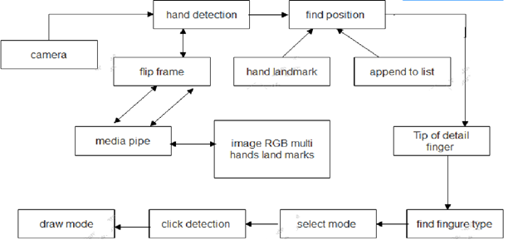
Proposed system architecture

Slide 17
Proposed Methods
It begins by setting up variables and initializing necessary libraries for hand detection and image processing.
Capture live video from a webcam using OpenCV library.
Utilize MediaPipe library to detect hands in each frame and locate key landmarks on the hand.
Analyze the positions of finger landmarks to determine which fingers are up or down.
Implement different modes based on finger positions - selection mode when two fingers are up and drawing mode when the index finger is up.
Enable drawing functionality using finger movements, allowing users to select colors from a predefined palette. Apply image processing techniques like thresholding and bitwise operations to improve drawing accuracy.

Slide 18
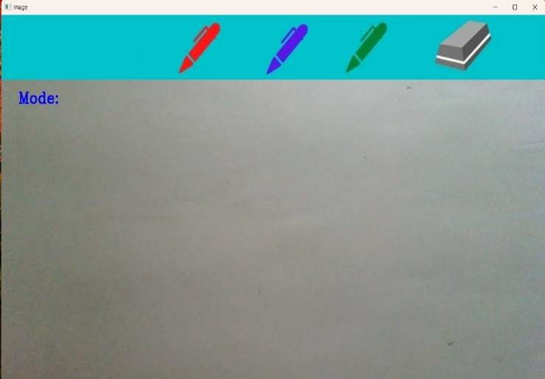
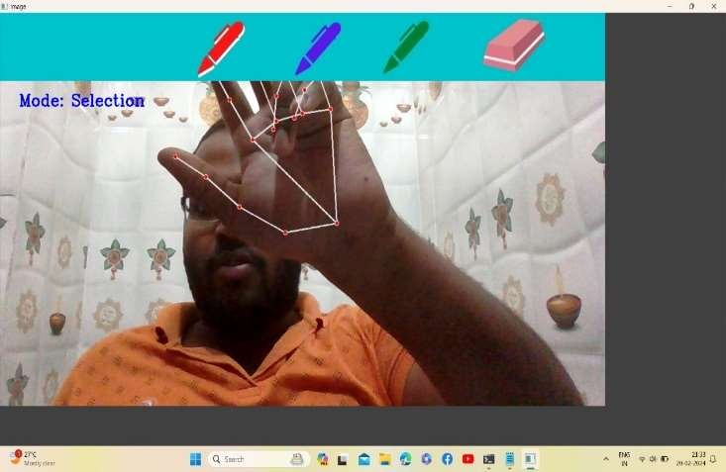
Performance Measure
The Graphical User Interface of the application which includes a canvas on which our text will be displayed on writing, a header consisting of three different colors to choose for writing, an eraser to clear the text and a mode which displays selection or drawing based on the action performed.
The selection of the color red by using two fingers index and middle, where that color gets captured and can access it for writing on the screen. Mode also displays selection as we are selecting from the header.

Slide 19
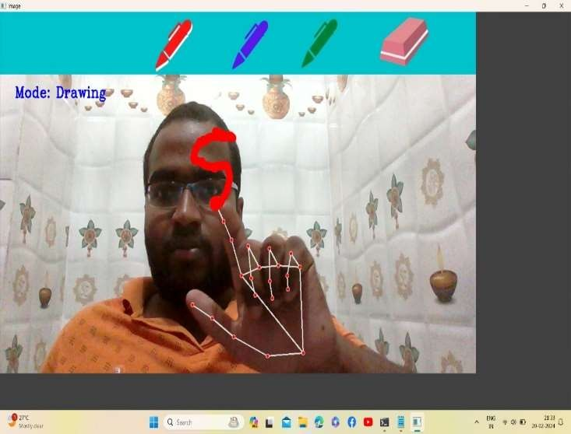
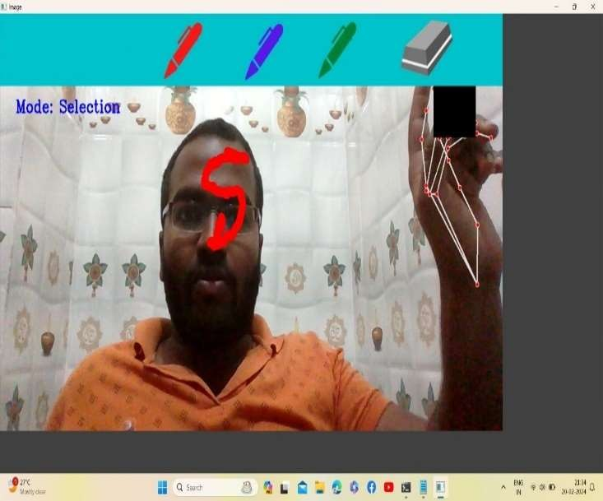
The writing of the text based on our hand movements and this can done by using only index finger. Mode also displays drawing, as it detects the writings on the screen.
The selection of the eraser to clear the written text on the screen.

Slide 20
Result Analysis
A Whiteboard application using a machine learning model can yield a range of significant results. Firstly, it can enhance user experience by effectively recognizing and converting handwritten text and drawings on the virtual whiteboard into digital text or vector graphics. This not only improves legibility but also enables advanced functionalities such as searchability and editing. Additionally, machine learning enables users to intuitively manipulate digital content, such as resizing, moving, and rotating objects, through gesture recognition, resulting in a smoother, more interactive interface. Moreover, the application can significantly reduce errors in handwriting recognition, thus boosting efficiency and user confidence.

Slide 21
Conclusion
The Whiteboard application using machine learning model project provides an exciting and interactive canvas for users to express themselves, explore their artistic talents, and engage with technology in a creative way. By seamlessly combining hand tracking, gesture recognition, and various interactive features, this project offers a unique and enjoyable drawing experience, making it suitable for both entertainment and educational purposes. Whether used as a creative outlet, a tool for communication, or a gaming platform, this project promises to captivate users and immerse them in a world of digital artistry.

Slide 22
Future Work
In future iterations of the whiteboard application leveraging machine learning models, there is a significant potential for enhancing gesture recognition capabilities. This could involve incorporating more advanced deep learning techniques such as convolutional neural networks (CNNs) or recurrent neural networks (RNNs) to improve the accuracy and robustness of hand gesture recognition. Additionally, exploring the integration of 3D hand pose estimation models could enable more precise tracking of hand movements in three-dimensional space, allowing for more natural and intuitive interactions with the virtual whiteboard. Furthermore, leveraging transfer learning approaches and continuously training the models with diverse datasets could enhance their adaptability to different user gestures and environments, making the application more versatile and user-friendly.

Slide 23
References
[1] Kamlakant Bag1, Siddharth Urankar2, Ankita Yadav3, Resham Chaudhari4 in the International Journal of Research Publication and Reviews, Vol 4, no 4, pp 592-598 April 2023.
[2] Dr. S. K. Sonkar1 , Gouri Aher2 , Nikita Anerao 3, Shivam Gavhale AdityaKadlag in International Journal of Advanced Research Science, Communication and Technology (IJARSCT) Volume 6, Issue 1, June 2021.
[3] Swapna Singh, Hiya Shukla, Keshav Sharma, Harsh Tyagi, Jaya Prasad in IPEC Journal of Science & Technology, Vol. 02 (01), June 2023.
[4] Ashvita Salian in Industrial Engineering Journal ISSN: 0970-2555 Volume : 52, Issue 7, No. 4, July : 2023.
[5] Dr.G.Shyama Chandra Prasad, 2Varsha Bandi , 3Baline Yugendhar 4 Daki AnilRaj in IJCRT | Volume 11, Issue 5 May 2023.

Slide 24
Thank You!

